Slide 1
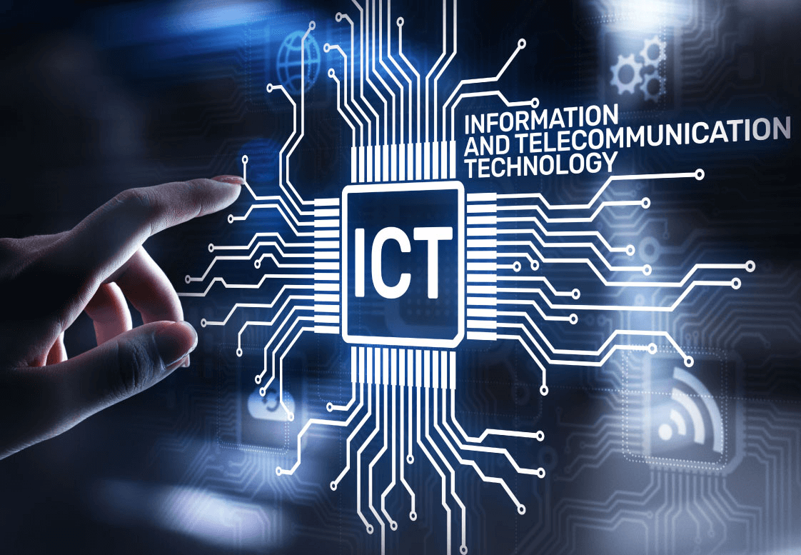

The Role of Information and Communication Technologies in Modern Society
Presented by:-
Syed Badar Ali Naqvi 24K-3079

Slide 2
Content:-
Components of ICT
Impact of ICT on Society
ICT in Business and Education
Challenges in ICT
Future Trends
Introduction
Conclusion

Slide 3
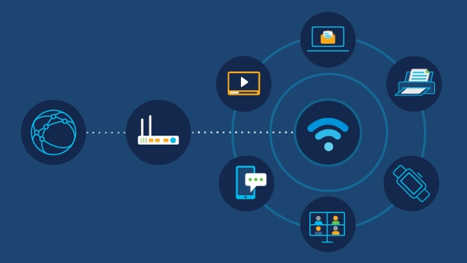
Introduction to ICT
“ICT refers to technologies that provide access to information through telecommunications, including the internet, wireless networks, cell phones, computers, software, and other media.”

Slide 4
Components of ICT:-
Hardware: Computers, mobile devices, servers.
Telecommunication Networks: The internet, broadband, 4G/5G networks.
Software: Operating systems, applications.
Data Management Systems: Cloud computing, databases

Slide 5
Impact of ICT on Society
The positive and negative effects of ICT:
Positive | Negative
Global communication | Digital divide
Increased access to information | Privacy concerns
Improved healthcare | Cybersecurity threats
E-commerce

Slide 6
ICT in Business
How businesses leverage ICT for:
E-commerce: Online shopping, payment systems.
Data Analysis: Big Data, AI, decision-making.
Communication: Emails, video conferencing, VoIP.

